Slide 1
ML Model Evaluation
Dr. Sugata Ghosal
CSIS Off-Campus Faculty
BITS Pilani

Slide 2
Agenda
Emerging Requirements
Bias and Fairness
Interpretability
Worked Out Problems

Slide 3

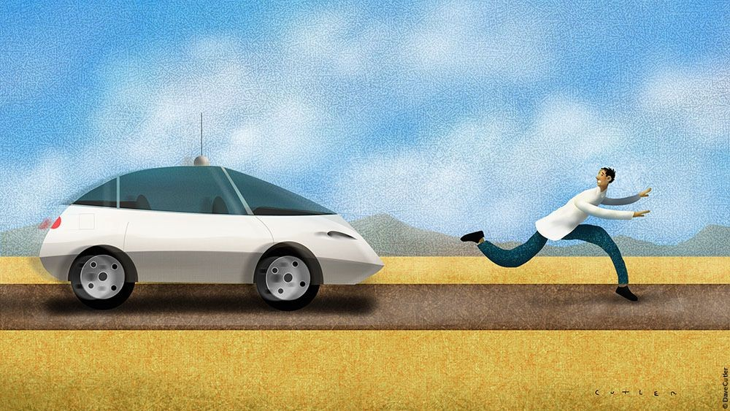


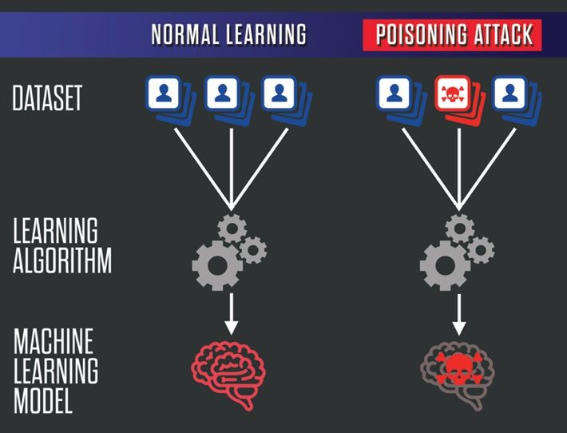
Emerging Requirements
Fairness
What to do to ensure gender and ethnic fairness in ML models?
Accountability
Who takes the responsibilities for failed ML models?
Transparency
What to do to make ML models transparent and comply with regulations?
Privacy Issues
How to protect user privacies when exposing data to ML models?
Security Issues
How do we defend ML models against data poisoning?

Slide 4
FAccT Overview
Psychology Social Science Public Policy
Fairness
Accountability
Statistics
Theory
Transparency
Machine Learning
Privacy
Robustness

Slide 5
Fairness
https://www.borealisai.com/research-blogs/tutorial1-bias-and-fairness-ai/
What is Fairness?
The absence of bias towards an individual or a group (Mehrabi et al, 2019)
Can ML Models Discriminate?
Aren't machines just follow human's instructions?
ML models approximate patterns in the data
Learns/Amplifies biases at the same time

Slide 6
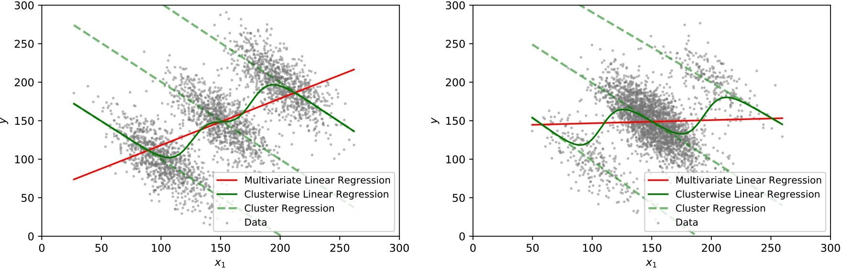
Model Sensitivity to Data Bias
red - biased regression
dashed green - regression for each subgroup solid green - unbiased regression

Slide 7
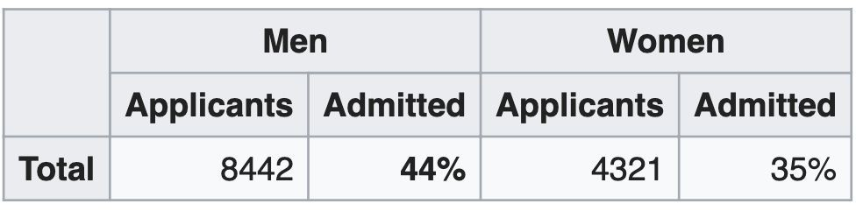
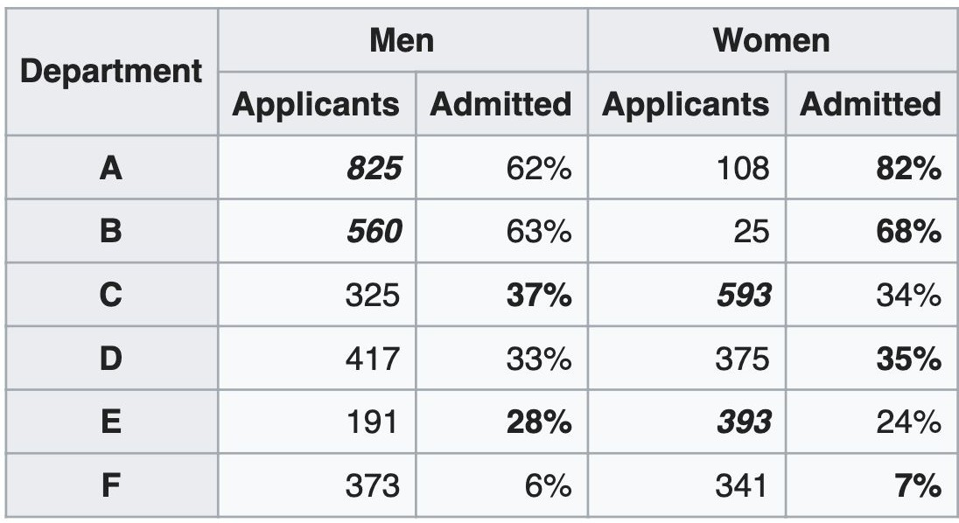
Simpson’s Paradox - Aggregation Bias
https://en.wikipedia.org/wiki/Simpson%27s_paradox

Slide 8
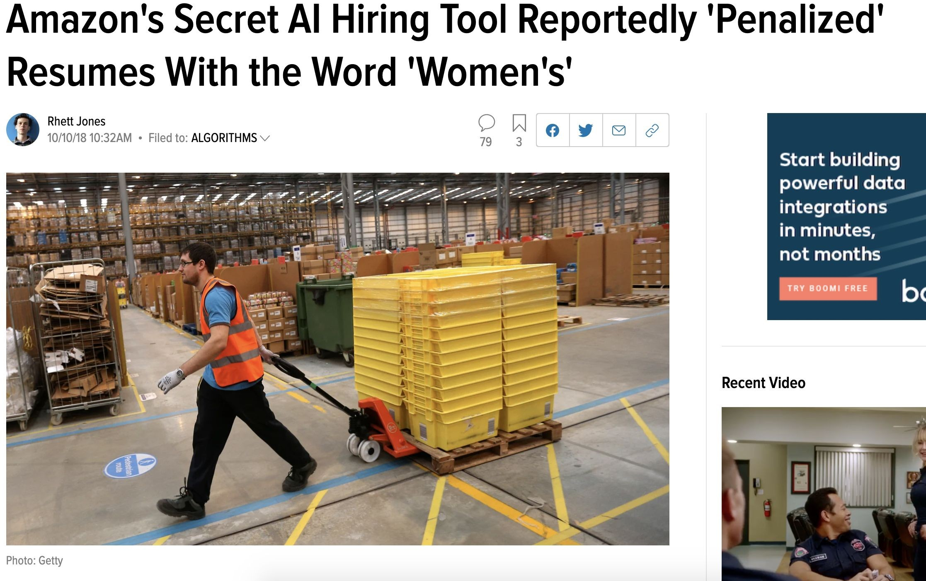
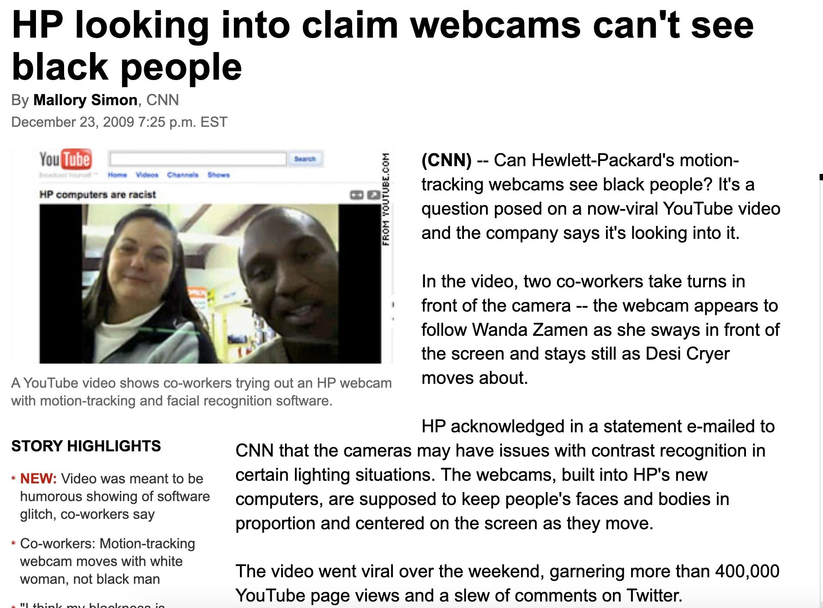
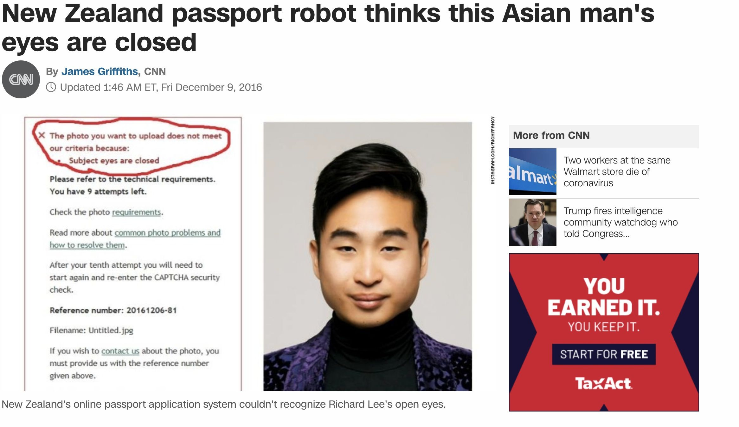
Real World Example

Slide 9
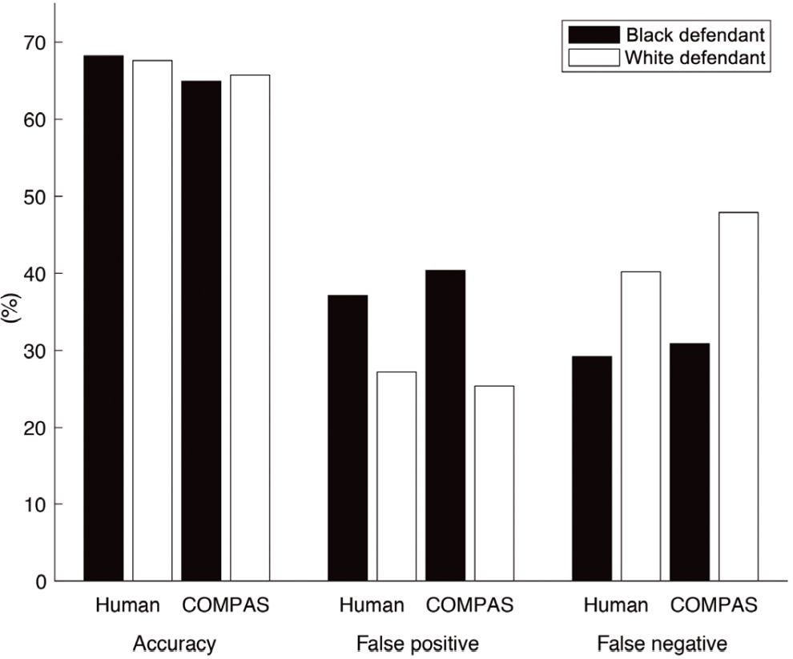
Algorithmic Bias
Commercial risk assessment software known as COMPAS
Assess more than 1 million offenders since 2000
Predicts a defendant’s risk of committing a misdemeanor or felony
137 features
Dressel et al, 2018

Slide 10
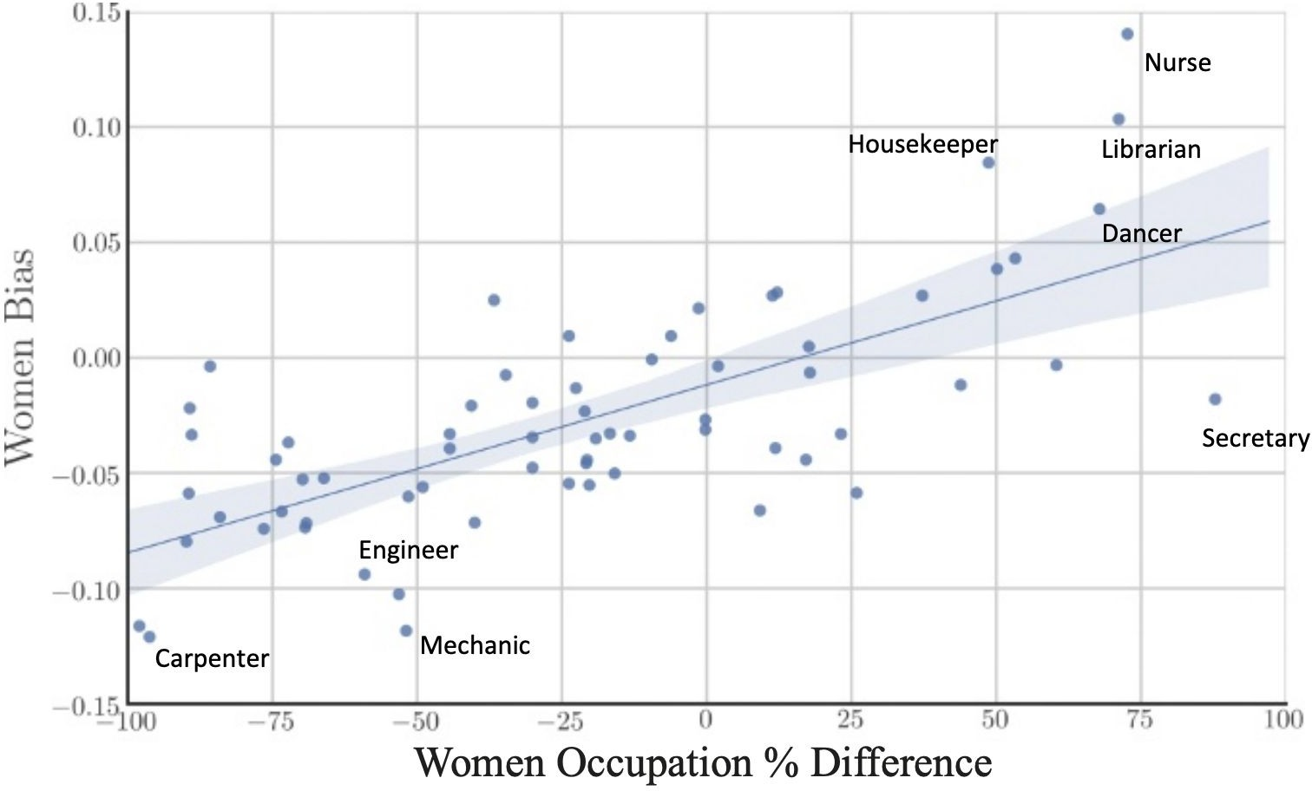
Bias in Historical Data – Negative Legacy
Gard et al, 2018

Slide 11
Fairness Through Unawareness
A ML Algorithm Achieves Fair Through Unawareness If
None of the sensitive features are directly used in the model
Race and Ethnicity | Skills | Years of Exp | Hired?
Hispanic | Javascript | 1 | no
Hispanic | C++ | 5 | yes
White | Java | 2 | yes
White | C++ | 3 | yes
Fair ML Model
Training

Slide 12
Issues With Fairness Through Unawareness
Sensitive Features May Still Be Used
Inferred from indirect evidence
Inferred
Protected
Race and Ethnicity | Skills | Years of Exp | Often Goes to Mexican Markets | Hiring Decision | Training
Hispanic | Javascript | 1 | yes | no
Hispanic | C++ | 5 | yes | yes
White | Java | 2 | no | yes
White | C++ | 3 | no | yes
Discriminatory ML Model

Slide 13
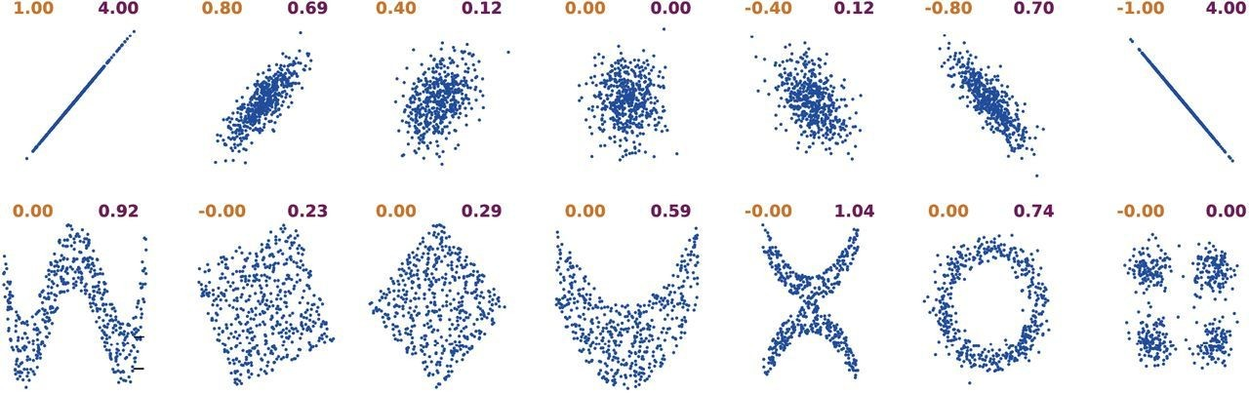
Correlation Coefficient and Mutual Information
Correlation Coefficient (left) and Mutual Information (right)
Ince et al, 2016

Slide 14

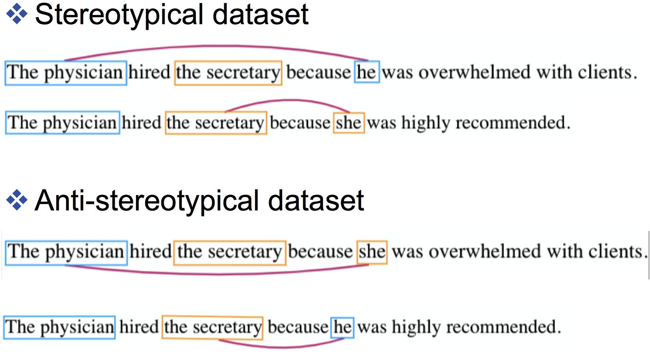
Limitations
Processing Sensitive Features
Fairness through unawareness requires sensitive features to be masked out
Not easy to do in real life
Referred to as individual fairness criteria

Slide 15
Common Fairness Criteria
Demographic Parity
Equality of Odds
Equality of Opportunity

Slide 16
Demographic Parity
Demographic Parity Is Applied to a Group of Samples
Demographic Parity Is Applied to a Group of Samples
Does not require features to be masked out
A Predictor Ŷ Satisfies Demographic Parity If
The probabilities of positive predictions are the same regardless of whether the group is protected
Protected groups are identified as A = 1

Slide 17
Comparisons
Individual Treatment
Group Treatment
Protected Features A
Non-protected Features X
Protected Features = 1
Protected Features = 0
Fairness Through Unawareness P(Ŷ | X)
Demographic Parity P(Ŷ=1 | A =1)
Demographic Parity P(Ŷ=1 | A =0)

Slide 18
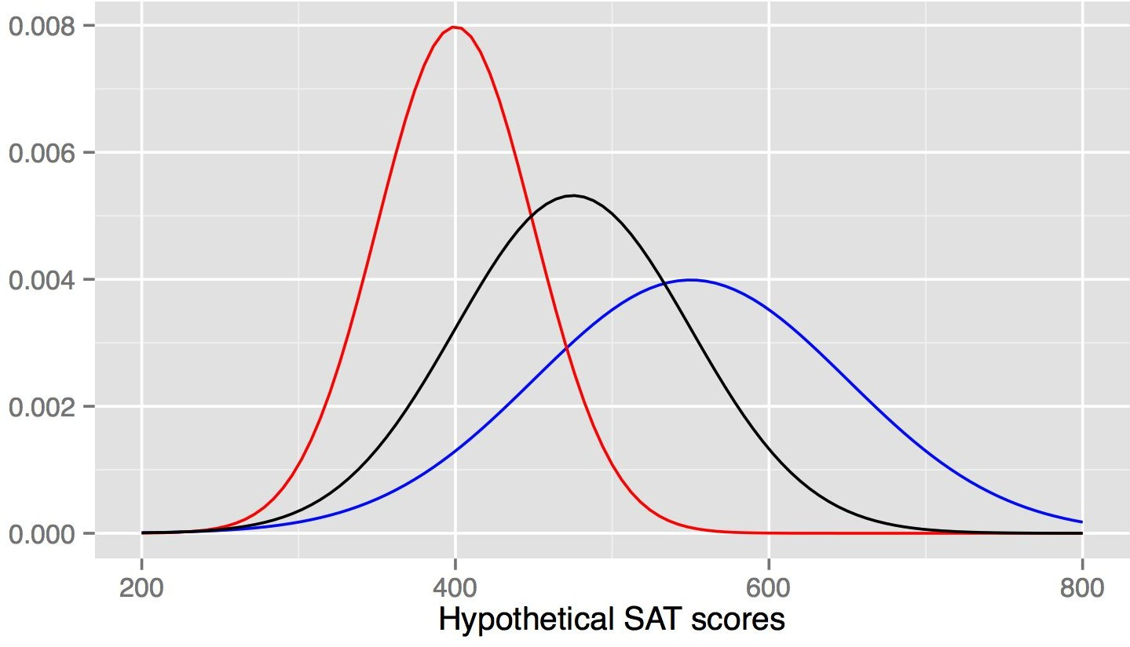
SAT Score Prediction
Unconstrained P(Ŷ=1 | A =1)
P(Ŷ=1 | A =0) = P(Ŷ=1 | A =0)
Unconstrained P(Ŷ=1 | A =0)
Ŷ
Feldman et al, 2015

Slide 19
Issues With Demographic Parity
Correlates Too Much With the Performance of the Predictor
predictor
predictor
A=0
match
A=1
P(Ŷ =0 | A=0)
P(Ŷ =1 | A=0)
P(Ŷ =1 | A=1)
P(Ŷ =0 | A=1)

Slide 20
Issues With Demographic Parity
Correlates Too Much With the Performance of the Predictor
Accepted too many who are not qualified
predictor
predictor
A=0
match
A=1
Y=0 Y=1
Y=0 Y=1
Y=1 Y=0
Y=1 Y=0
P(Ŷ =0 | A=0)
P(Ŷ =1 | A=0)
P(Ŷ =1 | A=1)
P(Ŷ =0 | A=1)

Slide 21
Equality of Odds
Equal Probabilities for Both Qualified/Unqualified People Across Protected Groups
A=0
match
A=1
Y=0 Y=1
Y=0 Y=1
Y=1 Y=0
Y=1 Y=0
P(Ŷ =0 | A=0)
P(Ŷ =1 | A=0)
P(Ŷ =1 | A=1)
P(Ŷ =0 | A=1)
Hardt et al, 2016

Slide 22
Equality of Opportunity
Equal Probabilities for Qualified People Across Protected Groups
A=0
match
A=1
Y=0 Y=1
Y=0 Y=1
Y=1 Y=0
Y=1 Y=0
P(Ŷ =0 | A=0)
P(Ŷ =1 | A=0)
P(Ŷ =1 | A=1)
P(Ŷ =0 | A=1)
Hardt et al, 2016

Slide 23
Practice Question
Find out the Fairness Criteria that Ŷ1, and Ŷ2 Satisfy
A = {race}, Y = {Hiring Decision}
Race and Ethnicity | Skill | Years of Exp | Goes to Mexican Markets? | Hiring Decision Y | Predictor Ŷ₁ | Predictor Ŷ₂
Hispanic | Javascript | 1 | yes | no | 0 | 1
Hispanic | C++ | 5 | yes | yes | 1 | 1
Hispanic | Python | 1 | no | yes | 1 | 0
White | Java | 2 | no | yes | 0 | 0
White | C++ | 3 | no | yes | 1 | 1
White | C++ | 0 | no | no | 1 | 0

Slide 24
Demographic Parity for Predictor Ŷ1
P(Ŷ1 = 1 | R = H) = 2/3
P(Ŷ1 = 1 | R = W) =
Race and Ethnicity | Skill | Years of Exp | Goes to Mexican Markets? | Hiring Decision Y | Predictor Ŷ₁ | Predictor Ŷ₂
Hispanic | Javascript | 1 | yes | no | 0 | 1
Hispanic | C++ | 5 | yes | yes | 1 | 1
Hispanic | Python | 1 | no | yes | 1 | 0
White | Java | 2 | no | yes | 0 | 0
White | C++ | 3 | no | yes | 1 | 1
White | C++ | 0 | no | no | 1 | 0

Slide 25
Demographic Parity for Predictor Ŷ1
P(Ŷ1 = 1 | R = H) = 2/3
P(Ŷ1 = 1 | R = W) = 2/3
Race and Ethnicity | Skill | Years of Exp | Goes to Mexican Markets? | Hiring Decision Y | Predictor Ŷ₁ | Predictor Ŷ₂
Hispanic | Javascript | 1 | yes | no | 0 | 1
Hispanic | C++ | 5 | yes | yes | 1 | 1
Hispanic | Python | 1 | no | yes | 1 | 0
White | Java | 2 | no | yes | 0 | 0
White | C++ | 3 | no | yes | 1 | 1
White | C++ | 0 | no | no | 1 | 0

Slide 26
Demographic Parity for Predictor Ŷ1
P(Ŷ1 = 1 | R = H) = 2/3
P(Ŷ1 = 1 | R = W) = 2/3
✔Demographics Parity
Race and Ethnicity | Skill | Years of Exp | Goes to Mexican Markets? | Hiring Decision Y | Predictor Ŷ₁ | Predictor Ŷ₂
Hispanic | Javascript | 1 | yes | no | 0 | 1
Hispanic | C++ | 5 | yes | yes | 1 | 1
Hispanic | Python | 1 | no | yes | 1 | 0
White | Java | 2 | no | yes | 0 | 0
White | C++ | 3 | no | yes | 1 | 1
White | C++ | 0 | no | no | 1 | 0

Slide 27
Equality of Opportunity/Odds for Predictor Ŷ1
P(Ŷ1 = 1 | R = H, Y = yes) = 1
P(Ŷ1 = 1 | R = W, Y = yes) =
P(Ŷ1 = 1 | R = H, Y = no) =
P(Ŷ1 = 1 | R = W, Y = no) =
Race and Ethnicity | Skill | Years of Exp | Goes to Mexican Markets? | Hiring Decision Y | Predictor Ŷ₁ | Predictor Ŷ₂
Hispanic | Javascript | 1 | yes | no | 0 | 1
Hispanic | C++ | 5 | yes | yes | 1 | 1
Hispanic | Python | 1 | no | yes | 1 | 0
White | Java | 2 | no | yes | 0 | 0
White | C++ | 3 | no | yes | 1 | 1
White | C++ | 0 | no | no | 1 | 0

Slide 28
Equality of Opportunity/Odds for Predictor Ŷ1
P(Ŷ1 = 1 | R = H, Y = yes) = 1
P(Ŷ1 = 1 | R = W, Y = yes) = 0.5
P(Ŷ1 = 1 | R = H, Y = no) =
P(Ŷ1 = 1 | R = W, Y = no) =
Race and Ethnicity | Skill | Years of Exp | Goes to Mexican Markets? | Hiring Decision Y | Predictor Ŷ₁ | Predictor Ŷ₂
Hispanic | Javascript | 1 | yes | no | 0 | 1
Hispanic | C++ | 5 | yes | yes | 1 | 1
Hispanic | Python | 1 | no | yes | 1 | 0
White | Java | 2 | no | yes | 0 | 0
White | C++ | 3 | no | yes | 1 | 1
White | C++ | 0 | no | no | 1 | 0

Slide 29
Equality of Opportunity/Odds for Predictor Ŷ1
P(Ŷ1 = 1 | R = H, Y = yes) = 1
P(Ŷ1 = 1 | R = W, Y = yes) = 0.5
P(Ŷ1 = 1 | R = H, Y = no) = 0
P(Ŷ1 = 1 | R = W, Y = no) =
Race and Ethnicity | Skill | Years of Exp | Goes to Mexican Markets? | Hiring Decision Y | Predictor Ŷ₁ | Predictor Ŷ₂
Hispanic | Javascript | 1 | yes | no | 0 | 1
Hispanic | C++ | 5 | yes | yes | 1 | 1
Hispanic | Python | 1 | no | yes | 1 | 0
White | Java | 2 | no | yes | 0 | 0
White | C++ | 3 | no | yes | 1 | 1
White | C++ | 0 | no | no | 1 | 0

Slide 30
Equality of Opportunity/Odds for Predictor Ŷ1
P(Ŷ1 = 1 | R = H, Y = yes) = 1
P(Ŷ1 = 1 | R = W, Y = yes) = 0.5
P(Ŷ1 = 1 | R = H, Y = no) = 0
P(Ŷ1 = 1 | R = W, Y = no) = 1
Race and Ethnicity | Skill | Years of Exp | Goes to Mexican Markets? | Hiring Decision Y | Predictor Ŷ₁ | Predictor Ŷ₂
Hispanic | Javascript | 1 | yes | no | 0 | 1
Hispanic | C++ | 5 | yes | yes | 1 | 1
Hispanic | Python | 1 | no | yes | 1 | 0
White | Java | 2 | no | yes | 0 | 0
White | C++ | 3 | no | yes | 1 | 1
White | C++ | 0 | no | no | 1 | 0

Slide 31
Equality of Opportunity/Odds for Predictor Ŷ1
P(Ŷ1 = 1 | R = H, Y = yes) = 1
P(Ŷ1 = 1 | R = W, Y = yes) = 0.5
P(Ŷ1 = 1 | R = H, Y = no) = 0
P(Ŷ1 = 1 | R = W, Y = no) = 1
✗Equality of Opportunity
✗Equality of Odds
Race and Ethnicity | Skill | Years of Exp | Goes to Mexican Markets? | Hiring Decision Y | Predictor Ŷ₁ | Predictor Ŷ₂
Hispanic | Javascript | 1 | yes | no | 0 | 1
Hispanic | C++ | 5 | yes | yes | 1 | 1
Hispanic | Python | 1 | no | yes | 1 | 0
White | Java | 2 | no | yes | 0 | 0
White | C++ | 3 | no | yes | 1 | 1
White | C++ | 0 | no | no | 1 | 0

Slide 32
Demographic Parity for Predictor Ŷ2
P(Ŷ1 = 1 | R = H) = 2/3
P(Ŷ1 = 1 | R = W) =
Race and Ethnicity | Skill | Years of Exp | Goes to Mexican Markets? | Hiring Decision Y | Predictor Ŷ₁ | Predictor Ŷ₂
Hispanic | Javascript | 1 | yes | no | 0 | 1
Hispanic | C++ | 5 | yes | yes | 1 | 1
Hispanic | Python | 1 | no | yes | 1 | 0
White | Java | 2 | no | yes | 0 | 0
White | C++ | 3 | no | yes | 1 | 1
White | C++ | 0 | no | no | 1 | 0

Slide 33
Demographic Parity for Predictor Ŷ2
P(Ŷ1 = 1 | R = H) = 2/3
P(Ŷ1 = 1 | R = W) = 1/3
Race and Ethnicity | Skill | Years of Exp | Goes to Mexican Markets? | Hiring Decision Y | Predictor Ŷ₁ | Predictor Ŷ₂
Hispanic | Javascript | 1 | yes | no | 0 | 1
Hispanic | C++ | 5 | yes | yes | 1 | 1
Hispanic | Python | 1 | no | yes | 1 | 0
White | Java | 2 | no | yes | 0 | 0
White | C++ | 3 | no | yes | 1 | 1
White | C++ | 0 | no | no | 1 | 0

Slide 34
Demographic Parity for Predictor Ŷ2
P(Ŷ1 = 1 | R = H) = 2/3
P(Ŷ1 = 1 | R = W) = 1/3
✗Demographics Parity
Race and Ethnicity | Skill | Years of Exp | Goes to Mexican Markets? | Hiring Decision Y | Predictor Ŷ₁ | Predictor Ŷ₂
Hispanic | Javascript | 1 | yes | no | 0 | 1
Hispanic | C++ | 5 | yes | yes | 1 | 1
Hispanic | Python | 1 | no | yes | 1 | 0
White | Java | 2 | no | yes | 0 | 0
White | C++ | 3 | no | yes | 1 | 1
White | C++ | 0 | no | no | 1 | 0

Slide 35
Equality of Opportunity/Odds for Predictor Ŷ2
P(Ŷ1 = 1 | R = H, Y = yes) = 1/2
P(Ŷ1 = 1 | R = W, Y = yes) =
P(Ŷ1 = 1 | R = H, Y = no) =
P(Ŷ1 = 1 | R = W, Y = no) =
Race and Ethnicity | Skill | Years of Exp | Goes to Mexican Markets? | Hiring Decision Y | Predictor Ŷ₁ | Predictor Ŷ₂
Hispanic | Javascript | 1 | yes | no | 0 | 1
Hispanic | C++ | 5 | yes | yes | 1 | 1
Hispanic | Python | 1 | no | yes | 1 | 0
White | Java | 2 | no | yes | 0 | 0
White | C++ | 3 | no | yes | 1 | 1
White | C++ | 0 | no | no | 1 | 0

Slide 36
Demographic Parity for Predictor Ŷ2
P(Ŷ1 = 1 | R = H) = 2/3
P(Ŷ1 = 1 | R = W) = 1/3
✗Demographics Parity
Race and Ethnicity | Skill | Years of Exp | Goes to Mexican Markets? | Hiring Decision Y | Predictor Ŷ₁ | Predictor Ŷ₂
Hispanic | Javascript | 1 | yes | no | 0 | 1
Hispanic | C++ | 5 | yes | yes | 1 | 1
Hispanic | Python | 1 | no | yes | 1 | 0
White | Java | 2 | no | yes | 0 | 0
White | C++ | 3 | no | yes | 1 | 1
White | C++ | 0 | no | no | 1 | 0

Slide 37
Equality of Opportunity/Odds for Predictor Ŷ2
P(Ŷ1 = 1 | R = H, Y = yes) = 1/2
P(Ŷ1 = 1 | R = W, Y = yes) = 1/2
P(Ŷ1 = 1 | R = H, Y = no) =
P(Ŷ1 = 1 | R = W, Y = no) =
Race and Ethnicity | Skill | Years of Exp | Goes to Mexican Markets? | Hiring Decision Y | Predictor Ŷ₁ | Predictor Ŷ₂
Hispanic | Javascript | 1 | yes | no | 0 | 1
Hispanic | C++ | 5 | yes | yes | 1 | 1
Hispanic | Python | 1 | no | yes | 1 | 0
White | Java | 2 | no | yes | 0 | 0
White | C++ | 3 | no | yes | 1 | 1
White | C++ | 0 | no | no | 1 | 0

Slide 38
Equality of Opportunity/Odds for Predictor Ŷ2
P(Ŷ1 = 1 | R = H, Y = yes) = 1/2
P(Ŷ1 = 1 | R = W, Y = yes) = 1/2
P(Ŷ1 = 1 | R = H, Y = no) = 1
P(Ŷ1 = 1 | R = W, Y = no) =
Race and Ethnicity | Skill | Years of Exp | Goes to Mexican Markets? | Hiring Decision Y | Predictor Ŷ₁ | Predictor Ŷ₂
Hispanic | Javascript | 1 | yes | no | 0 | 1
Hispanic | C++ | 5 | yes | yes | 1 | 1
Hispanic | Python | 1 | no | yes | 1 | 0
White | Java | 2 | no | yes | 0 | 0
White | C++ | 3 | no | yes | 1 | 1
White | C++ | 0 | no | no | 1 | 0

Slide 39
Equality of Opportunity/Odds for Predictor Ŷ2
P(Ŷ1 = 1 | R = H, Y = yes) = 1/2
P(Ŷ1 = 1 | R = W, Y = yes) = 1/2
P(Ŷ1 = 1 | R = H, Y = no) = 1
P(Ŷ1 = 1 | R = W, Y = no) = 0
Race and Ethnicity | Skill | Years of Exp | Goes to Mexican Markets? | Hiring Decision Y | Predictor Ŷ₁ | Predictor Ŷ₂
Hispanic | Javascript | 1 | yes | no | 0 | 1
Hispanic | C++ | 5 | yes | yes | 1 | 1
Hispanic | Python | 1 | no | yes | 1 | 0
White | Java | 2 | no | yes | 0 | 0
White | C++ | 3 | no | yes | 1 | 1
White | C++ | 0 | no | no | 1 | 0

Slide 40
Equality of Opportunity/Odds for Predictor Ŷ2
P(Ŷ1 = 1 | R = H, Y = yes) = 1/2
P(Ŷ1 = 1 | R = W, Y = yes) = 1/2
P(Ŷ1 = 1 | R = H, Y = no) = 1
P(Ŷ1 = 1 | R = W, Y = no) = 0
✔Equality of Opportunity
✔
✗
✗Equality of Odds
Race and Ethnicity | Skill | Years of Exp | Goes to Mexican Markets? | Hiring Decision Y | Predictor Ŷ₁ | Predictor Ŷ₂
Hispanic | Javascript | 1 | yes | no | 0 | 1
Hispanic | C++ | 5 | yes | yes | 1 | 1
Hispanic | Python | 1 | no | yes | 1 | 0
White | Java | 2 | no | yes | 0 | 0
White | C++ | 3 | no | yes | 1 | 1
White | C++ | 0 | no | no | 1 | 0

Slide 41
Summary of Fairness Criteria
Fairness Criteria | Criteria | Group | Individual
Unawareness | Excludes A in Predictions |  | ✓
Demographic Parity |  | ✓
Equalized Odds |  | ✓
Equalized Opportunity |  | ✓

Slide 42
Fair Representation Learning
Make representations fair
Ensure fairness up to a certain level
x
z
fair
y

Slide 43
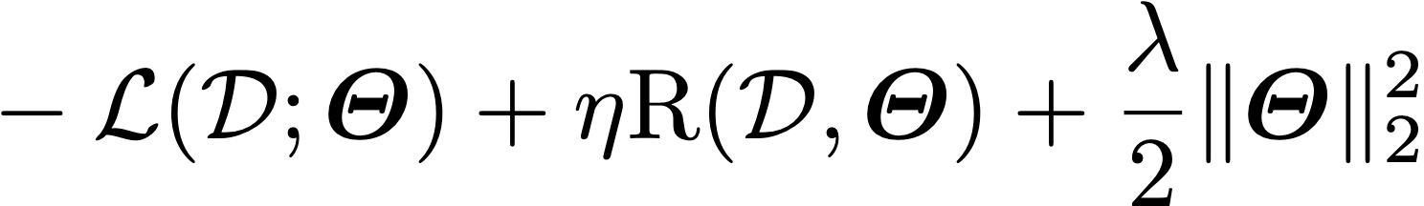
Prejudice Remover Regularizer
Quantified causes of unfairness
Prejudice
Unfairness rooted in the dataset
Underestimation
Model unfairness because the model is not fully converged
Negative Legacy
Unfairness due to sampling biases
Training Objective
Loss of the Model
Fairness Regularizer
L2 Regularizer
Kamishima et al, 2012

Slide 44
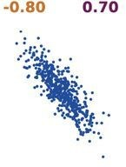
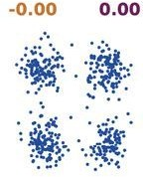
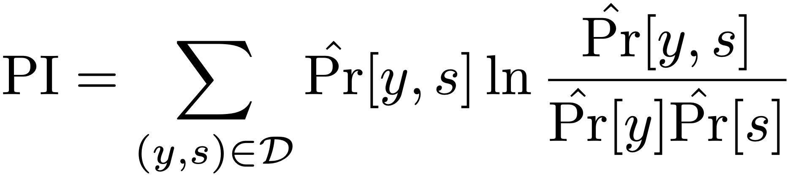
Prejudice Index (PI)
Recall that Indirect Discrimination Happens When
Prediction is not directly conditioned on sensitive variables S
Prediction is indirectly conditioned on S by a variable O that is dependent on S
Prejudice Index (PI)
Measures the degree of indirect discrimination based on mutual information
some prejudice little prejudice
Kamishima et al, 2012
prediction model

Slide 45
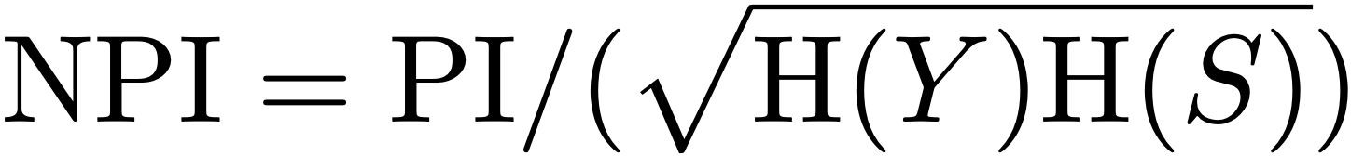
Normalized Prejudice Index (NPI)
Prejudice Index (PI)
Measures the degree of indirect discrimination based on mutual information
Ranges in [0, +∞)
Normalized Prejudice Index (NPI)
Normalize PI by the entropy of Y and S
Ranges in [0, 1]
Kamishima et al, 2012

Slide 46
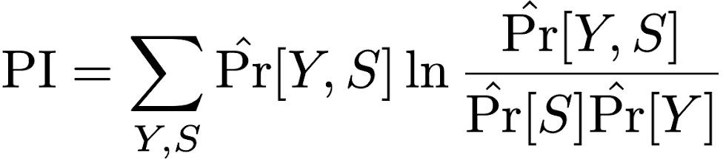
Optimizing PI
Learning PI
Kamishima et al, 2012

Slide 47
Optimizing PI
Expands Pr(Y, S) into Σ_{x}Pr(X, Y, S)
Learning PI
double summations
triple summations
Prediction Model
Using Logistic Regression Model as the Prediction Model
Kamishima et al, 2012

Slide 48

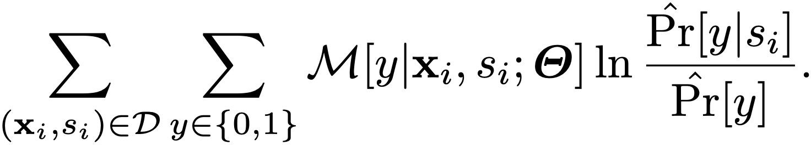
Optimizing PI
Learning PI
Using Logistic Regression Model as the Prediction Model
difficult to evaluate
Kamishima et al, 2012

Slide 49
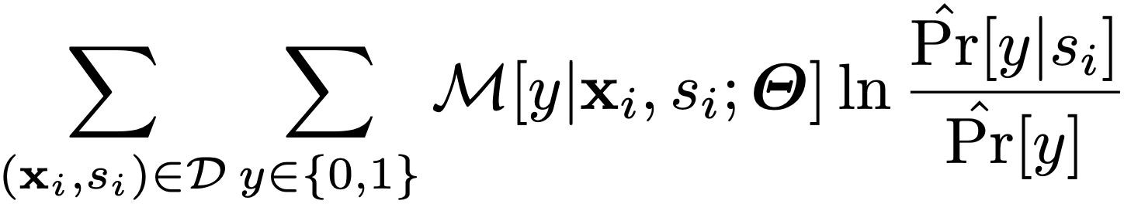
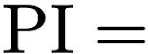
Optimizing PI
Kamishima et al, 2012

Slide 50
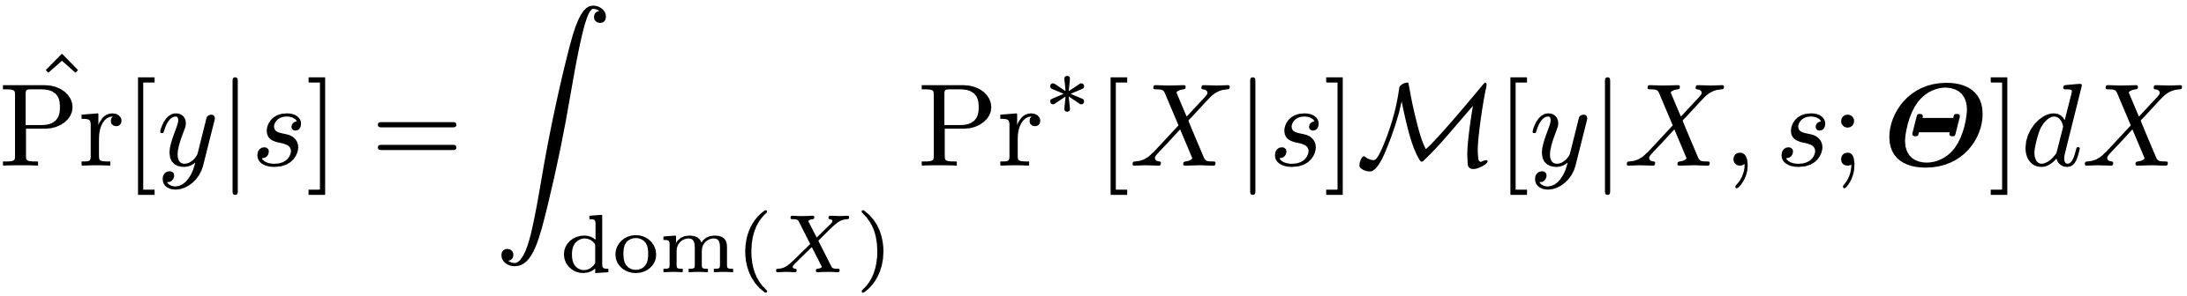
Optimizing PI
Integrals Are Difficult to Evaluate
Kamishima et al, 2012

Slide 51
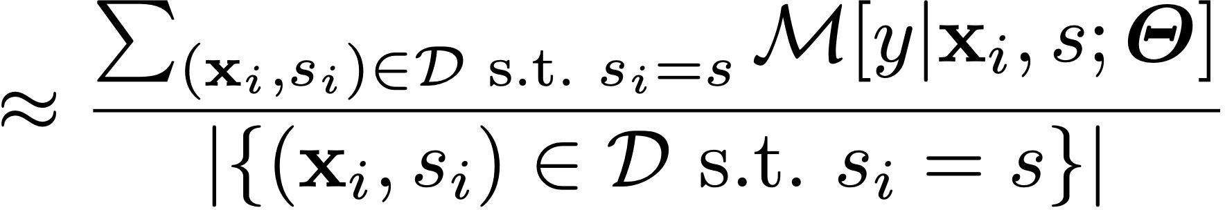
Optimizing PI
Approximating integrals by sample means
Kamishima et al, 2012

Slide 52
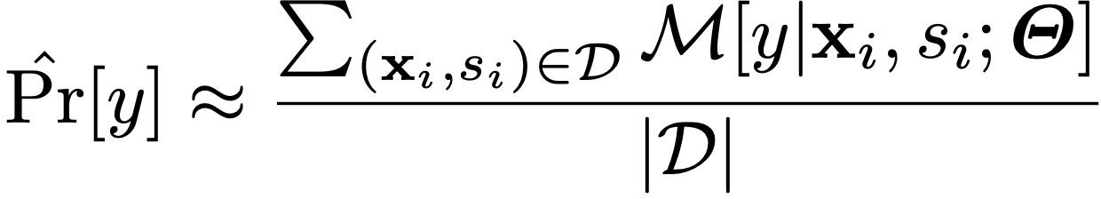
Optimizing PI
Approximating integrals by sample means
Kamishima et al, 2012

Slide 53
Optimizing PI
Kamishima et al, 2012

Slide 54
Putting Things Together
Optimization Target
Loss of the Model
Fairness Regularizer
L2 Regularizer
Fairness Regularizer
Kamishima et al, 2012

Slide 55
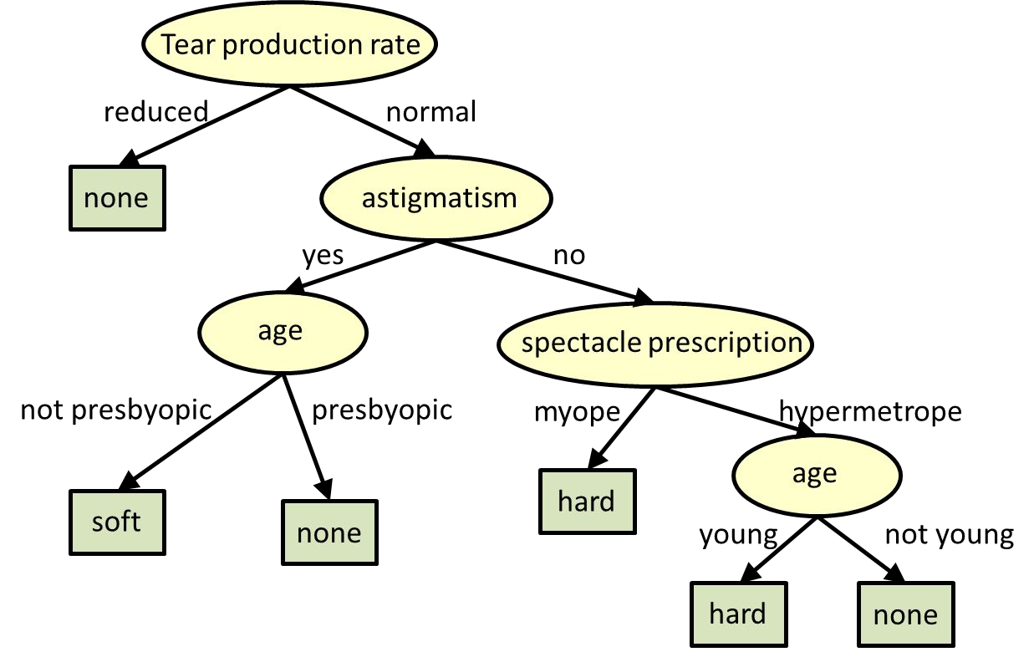
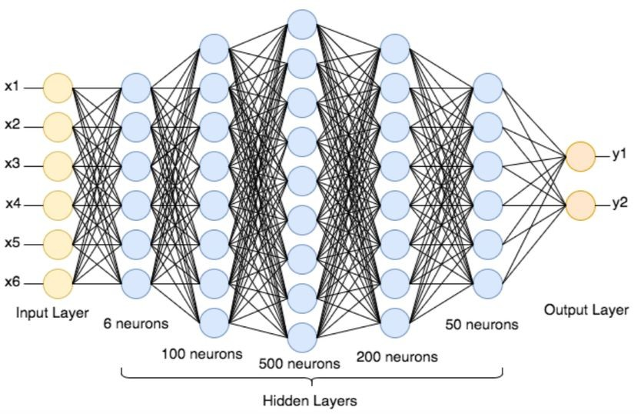
Machine Learning Interpretability
ML interpretability allows one to examine model's basis in its decision making process
A neural network which is usually considered a black-box model.
An interpretable tree model to find out the kind of contact lens a person may wear

Slide 56
Reasons for ML Interpretability
Our society has been shifted to rely on AI more than ever
autonomous vehicles
Security
Finance
many others
Who will benefit from ML Interpretability?
End Users: enhance trust, understand the consequences of the decisions, e.g., privacy, fairness.
Regulatory Agencies: compliance, audits, and accountability.
Model Designers: diagnose model performance

Slide 57
Right to Explanation
Credit Scores in United States
Equal Credit Opportunity Rights (Regulation B of the Code of Federal Regulations)
Creditors are required to notify applicants of action taken with statement of specific
European Union General Data Protection Regulation
GDPR 1995 provided a legally disputed form of a right to an explanation Recital 71
"The data subject should have the right not to be subject to a decision, which may include a measure, evaluating personal aspects relating to him or her which is based solely on automated processing..."
France
In a decision taken on the basis of an algorithmic treatment, the rules that define that treatment and its “principal characteristics” must be communicated to the citizen upon request
the degree and the mode of contribution of the algorithmic
the data processed and its source
the treatment parameters, and where appropriate, their weighting
the operations carried out by the treatment.

Slide 58
Intrinsic and Post Hoc Interpretability
https://www.borealisai.com/research-blogs/explainability-i-local-post-hoc-explanations/
https://www.borealisai.com/research-blogs/explainability-ii-global-explanations-proxy-models-and-interpretable-models/
Intrinsically interpretable models
Interpretable is achieved by model design
ML models are explainable by itself
Explainability is often achieved as a byproduct of model training
Interpretable Architecture
train
Interpretable Model
explain
Post Hoc/Model-specific methods
Explainability is often achieved after the model is trained
Interpretable is achieved using external methods
Black-box Architecture
train
Black-box Model
post-hoc methods
explain

Slide 59
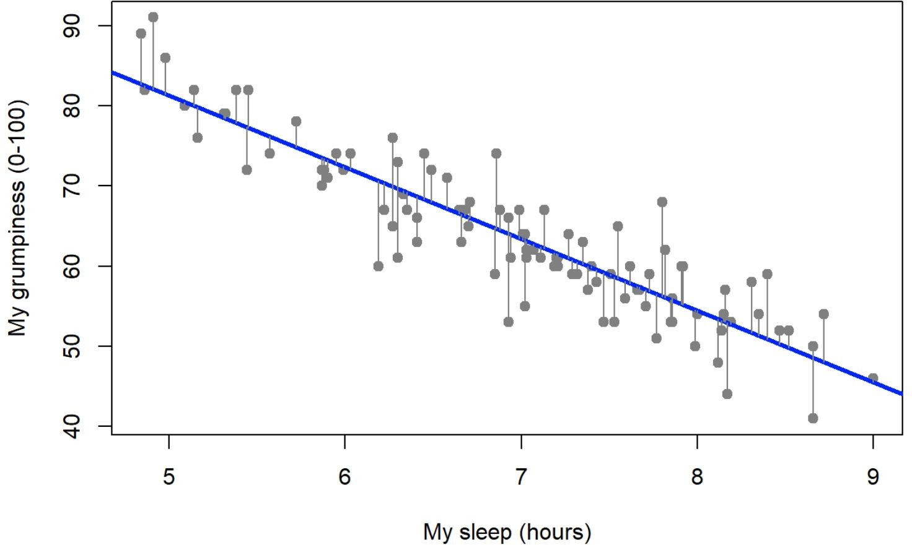
Linear Regression
interpretable components

Slide 60
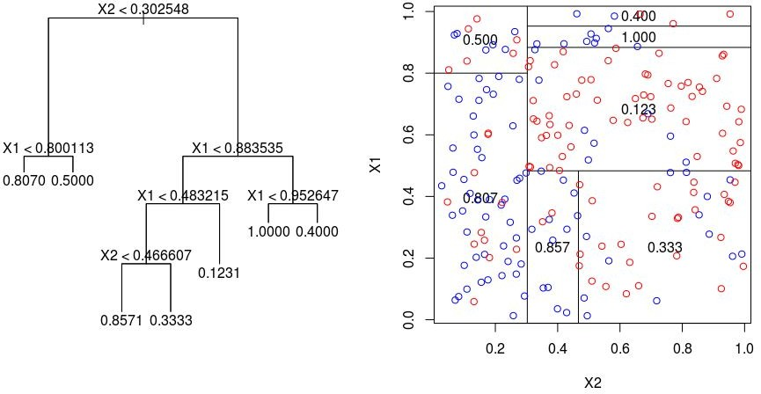
Decision Trees

Slide 61
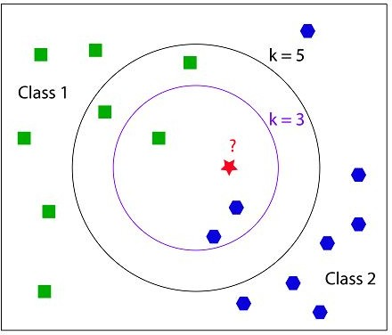
K-Nearest Neighbors

Slide 62
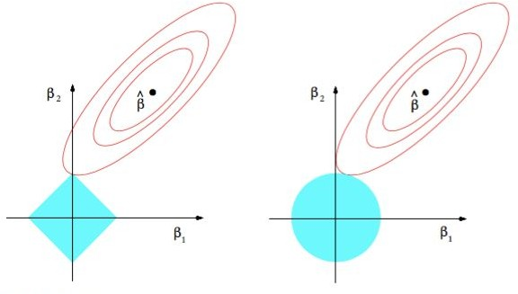
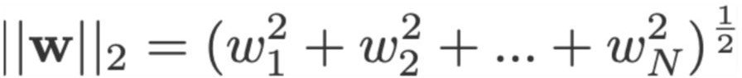
Sparsity
Controls the sparsity of model parameters when learning a model
Popular choices
L1 regularization
L2 regularization

Slide 63
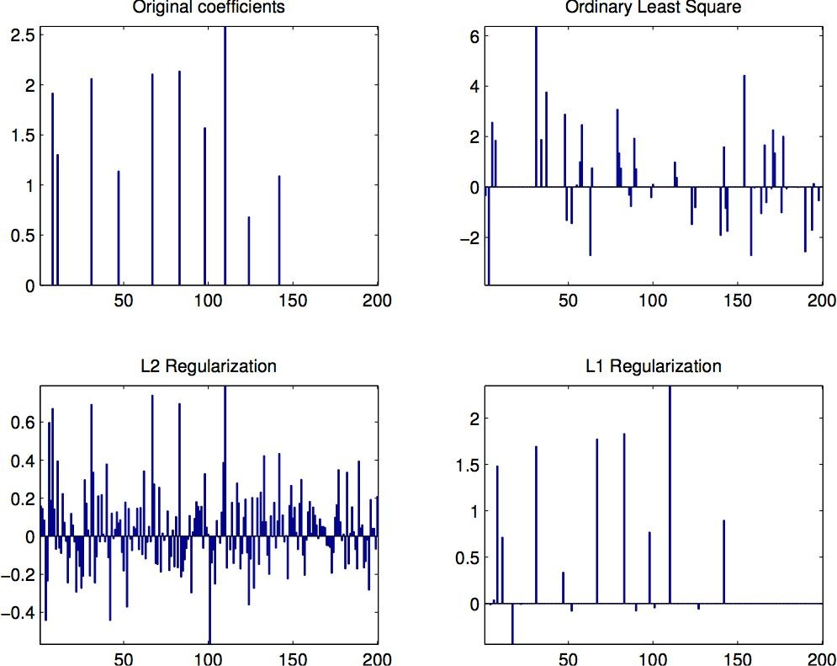
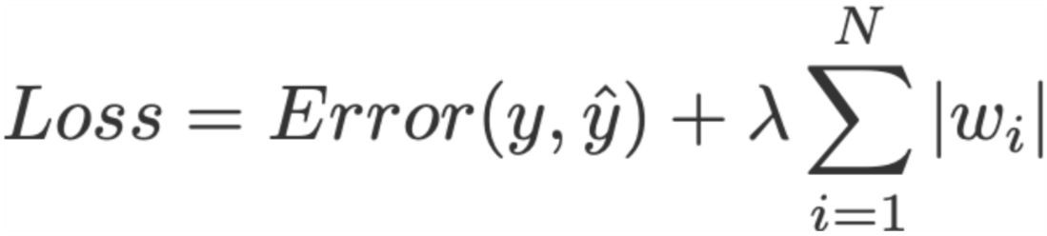
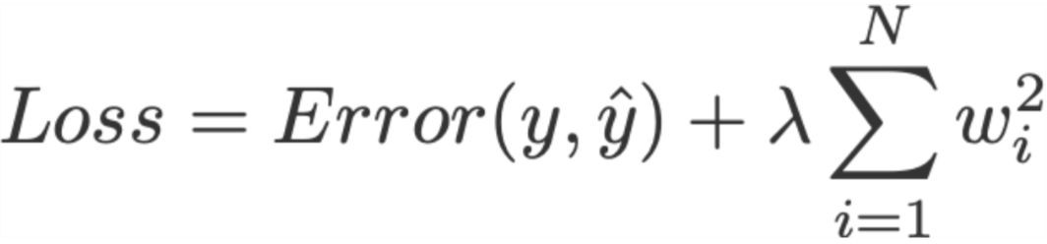
Sparsity for Interpretable Linear Regression
In the case of linear regression
○
Linear regression with L1 regularization
Linear Regression with L2 regularization

Slide 64
Post Hoc Interpretability
One of the way to achieve Post Hoc Interpretability is to deploy a local proxy model
Black Box Deep Learning Model | match behavior | Local Interpretable Model
Explain

Slide 65
Model Specific and Model Agnostic Methods
Model Specific Methods
Techniques that can be used for a specific architecture
Usually preferable when you have the ability to design your own model
Model specific techniques might compromise the performance of your model
Requires training the model using a dataset
Intrinsic methods are by definition model specific
Model-agnostic Methods
Techniques that can be used across many black box models
Model-agnostic methods will not affect the performance of your model
Do not require training the model
Post hoc methods are usually model-agnostic

Slide 66
Global and Local Interpretability
Global Interpretability
Explains the entire ML model at once from input to prediction
1) Holistic Model Interpretability
2) Modular Level Interpretability
e.g., Decision Trees, Linear regression
Local Interpretability
Explain how predictions change for when input changes
1) For a single prediction
2) for a group of predictions

Slide 67
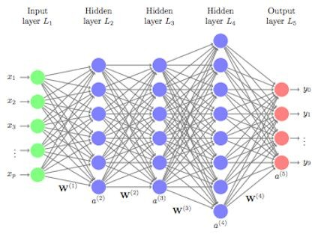
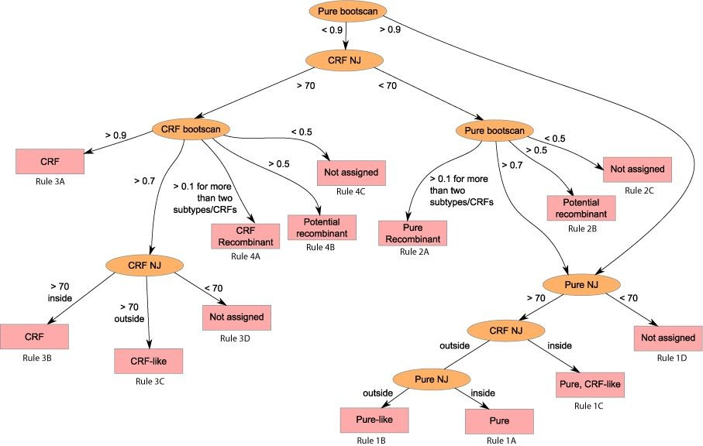
Global Interpretability
globally interpretable proxy

Slide 68
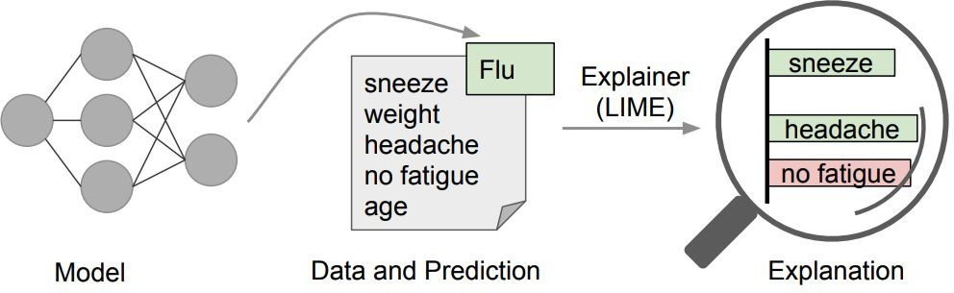
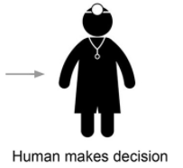
Local Interpretable Model-Agnostic Explanations (LIME)
LIME “explainer” that highlights the symptoms that are most important to the model or in other words rationale behind the model.
Perturb the input by changing components that make sense to humans (e.g., attributes of a record, or words or parts of an image), even if the model is using much more complicated components, and see how the prediction changes
Generate an explanation by approximating the underlying model by an interpretable one (such as a linear model with only a few non-zero coefficients), learned on perturbations of the original instance

Slide 69
Local Interpretable Model-Agnostic Explanations (LIME)
The key intuition behind LIME is that it is much easier to approximate a black-box model by a simple model locally (in the neighborhood of the prediction we want to explain), as opposed to trying to approximate a model globally.
the three highlighted symptoms may be a faithful approximation of the black-box model for patients who look like the one being inspected, but they probably do not represent how the model behaves for all patients.
In the case of an image (or text), perturbation may involve hiding parts of the image (or removing some words) and then weighting the perturbed images by their similarity to the instance we want to explain.

Slide 70
Shapley Additive Explanations (SHAP)
Inspired by cooperative game theory
Shapley value for each variable (payout) finds the correct weight such that the sum of all Shapley values is the difference between the predictions and average value of the model.
Shapley values correspond to the contribution of each feature towards pushing the prediction away from the expected value of predictions.
To get the importance of feature X{i}:
Get all subsets of features S that do not contain X{i}
Compute effect on our predictions of adding X{i} to all those subsets
Aggregate all contributions to compute the marginal contribution of the feature
Now, for these subsets, for the removed or left out feature, SHAP just replaces it with the average value of the feature and generates the predictions.

Slide 71
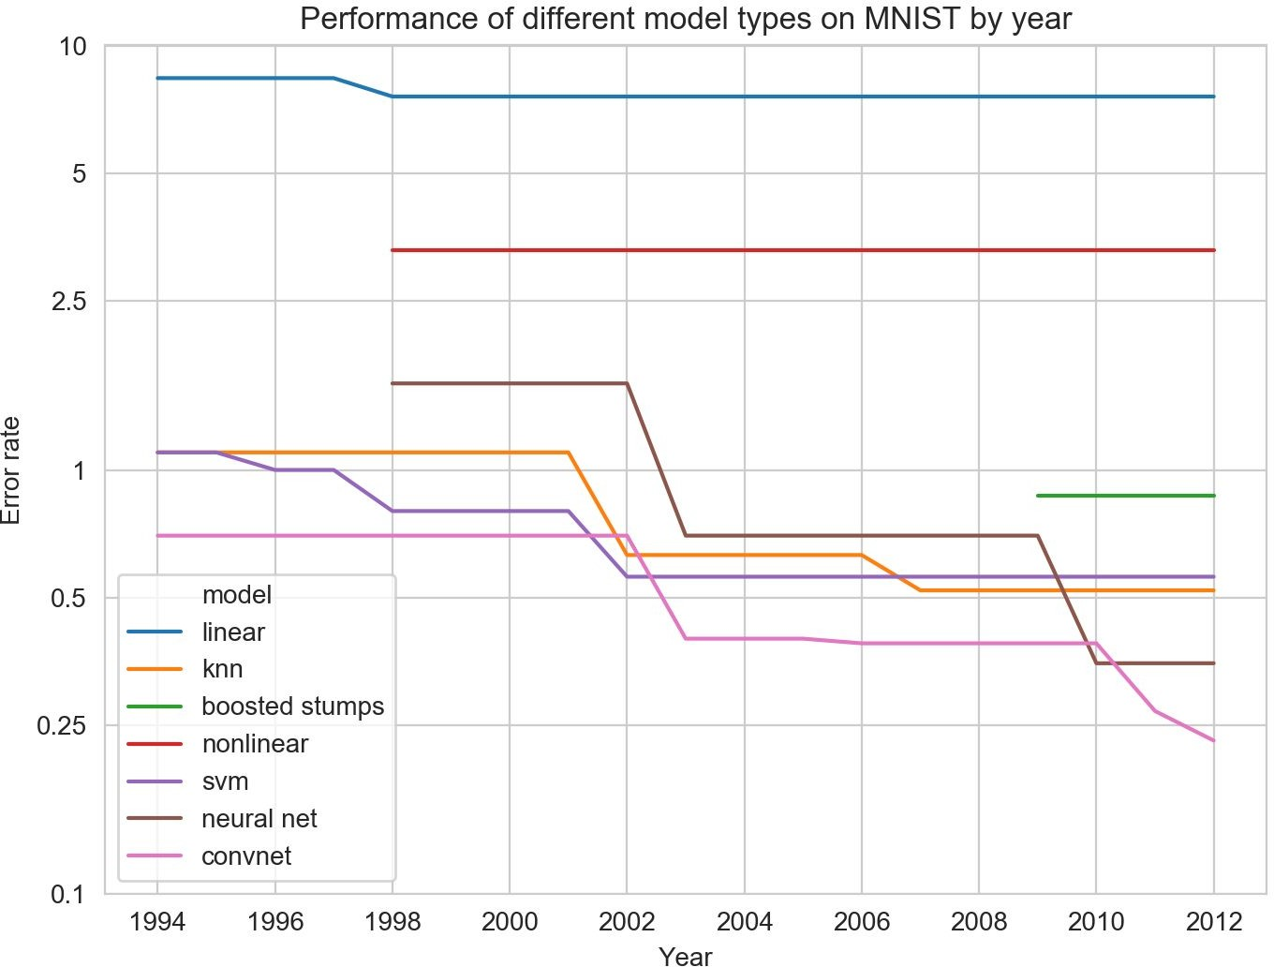
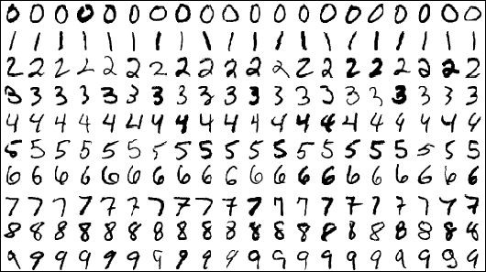

Interpretability and Performance Trade-offs
Highly performed models tend to be less interpretable.
Can powerful models with complex structures be interpretable at the same time?
more interpretable
less interpretable
MNIST Dataset
http://yann.lecun.com/exdb/mnist/ https://soph.info/2018/11/08/mnist-history/

Slide 72
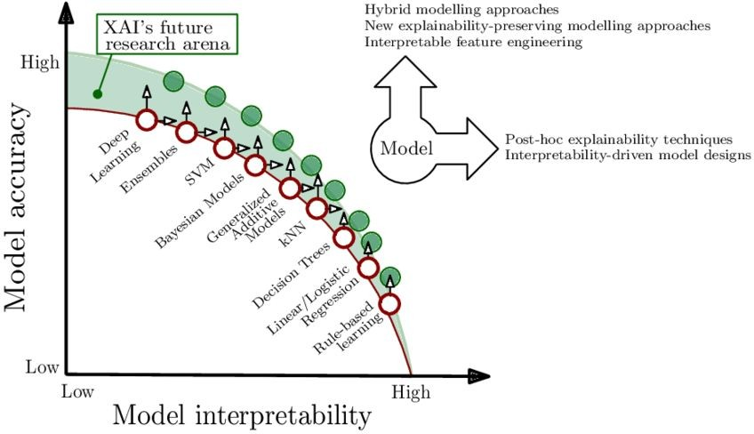
Interpretability and Performance Trade-offs
Arrieta et al., 2019

Slide 73
Worked Out Problems
Dr. Sugata Ghosal
CSIS Off-Campus Faculty
BITS Pilani

Slide 74
SVM
Solve the below and find the equation for hyper plane using linear Support Vector Machine method. Positive Points: {(3, 2), (4, 3), (2, 3), (3, -1)} Negative Points: {(1, 0), (-1, -1), (0, 2), (-1, 2)}. Find the support vectors. Determine the equation of hyperplane if it is changed and give a reason if it is not changed for the following two cases
If the point (2, 3) is removed. If the point (5,4) is added
(2,3)
(4,3)
(-1,2)
(0,2)
(3,2)
(1,0)
(-1,-1)
(3,-1)

Slide 75
SVM

Slide 76
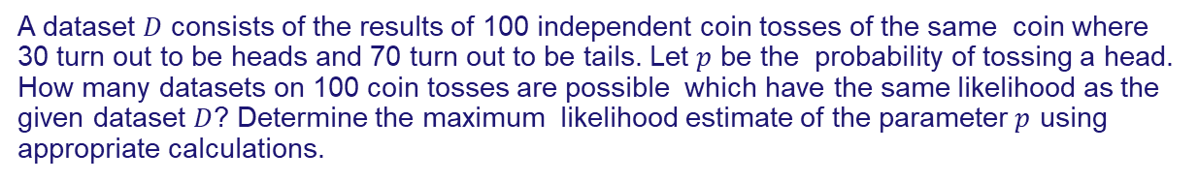
Bayesian Learning
A dataset $D$ consists of the results of 100 independent coin tosses of the same coin where 30 turn out to be heads and 70 turn out to be tails. Let $p$ be the probability of tossing a head. How many datasets on 100 coin tosses are possible which have the same likelihood as the given dataset $D$? Determine the maximum likelihood estimate of the parameter $p$ using appropriate calculations.

Slide 77
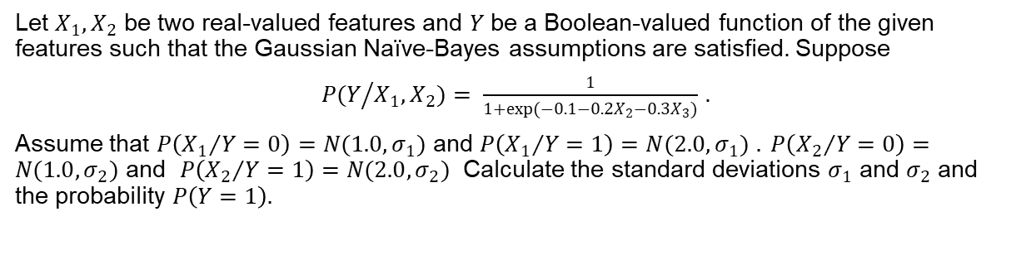
Bayesian Learning
Let $X_{1},X_{2}$ be two real-valued features and $Y$ be a Boolean-valued function of the given features such that the Gaussian Naïve-Bayes assumptions are satisfied. Suppose
$P(Y/{X_{1},X_{2})= \frac{1}{1+exp(−0.1−0.2X_{2}−0.3X_{3})}}$ .
Assume that $P\left({X_{1}}/{Y=0}\right)=N(1.0, σ_{1})$ and $P\left({X_{1}}/{Y=1}\right)=N(2.0, σ_{1})$ $. P\left({X_{2}}/{Y=0}\right)=N(1.0, σ_{2})$ and $P\left({X_{2}}/{Y=1}\right)=N(2.0, σ_{2})$ Calculate the standard deviations $σ_{1}$ and $σ_{2}$ and the probability $P\left(Y=1\right).$

Slide 78
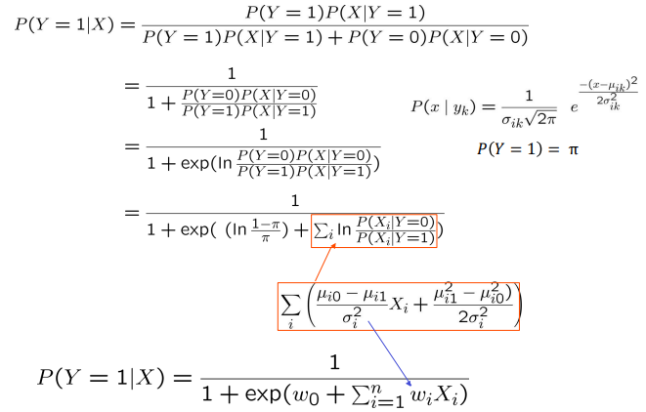
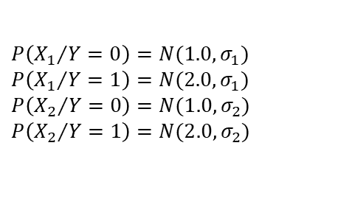
Bayesian Learning
$P\left({X_{1}}/{Y=0}\right)=N(1.0, σ_{1})$ $P\left({X_{1}}/{Y=1}\right)=N(2.0, σ_{1})$ $P\left({X_{2}}/{Y=0}\right)=N(1.0, σ_{2})$ $P\left({X_{2}}/{Y=1}\right)=N(2.0, σ_{2})$

Slide 79
Bayesian Learning

Slide 80
Bayesian Learning
Let say we have a dice of 4 sides. Where { (x,P(x)) : (0,a), (1,(1-a)/3), (2,(1-a)/2), (3,(1-a)/6) }. If the tossing event is observed as (0,1,2,3,2,3,1,0) then what is the most probable value of a ?

Slide 81
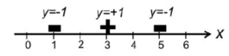
AdaBoost
Consider training an AdaBoost classifier using decision stumps on the following data set. Decision stump classifier chooses a constant value c and classifies all points where x > c as one class and other points where x ≤ c as the other class.
What is the initial weight that is assigned to each data point?
2. Show the decision boundary for the first decision stump.
3. Calculate the importance of the first decision stump.
4. Calculate the weights for the next iteration increases in the boosting process

Slide 82
AdaBoost

Slide 83
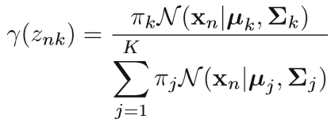
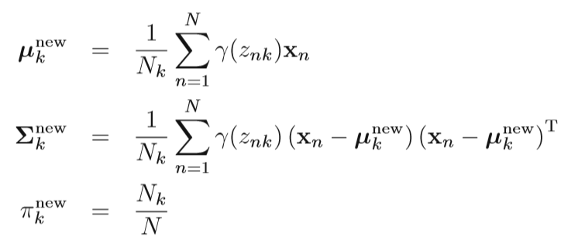
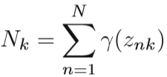
EM Maximization
Suppose we have the following one-dimensional data at -4.0, -.3.0, -2.0, -1.0, 0.0, 1.0, 2.0, 3.0, 4.0. Use the EM algorithm to find a Gaussian mixture model consisting of exactly one Gaussian that fits the data. Assume that the initial mean of the Gaussian is 10.0 and the initial variance is 1.0.

